Slide 1
Geomagnetic Storm
7/18/2022 – 7/21/2022
Brought to you by: Kai Chen
Mentored by Dr. Mei-Ching, Cristian, and Suk-Bin

Slide 2
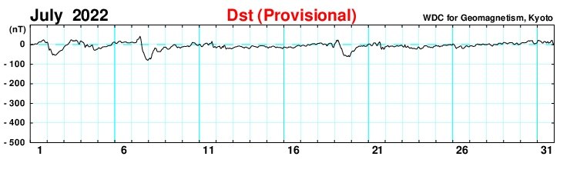
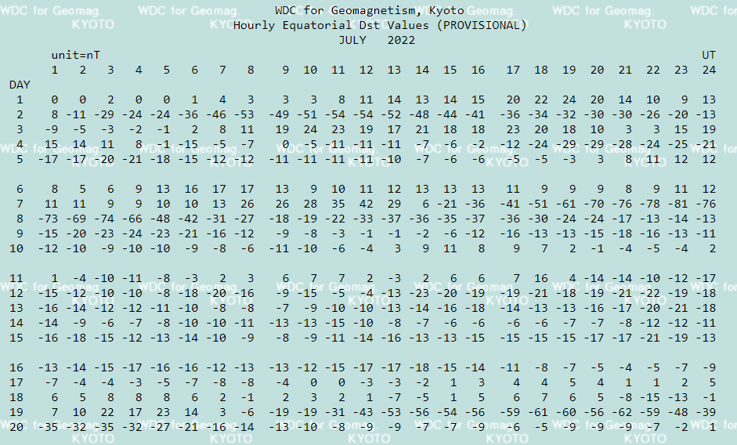
Time range

Slide 3
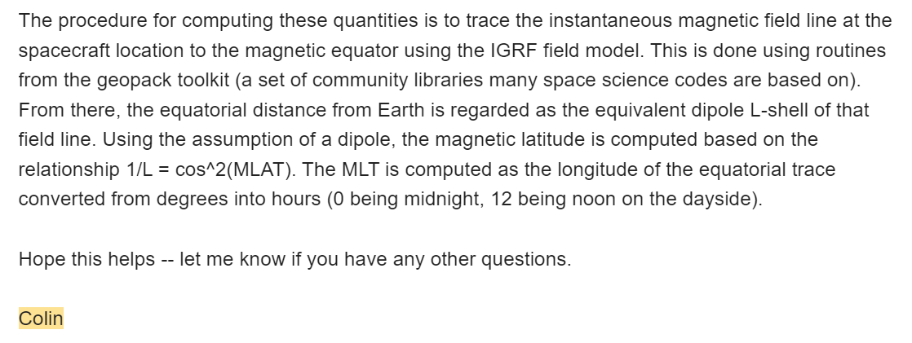
Colin’s Note on Reading Position Data

Slide 4
7/18/2022

Slide 5
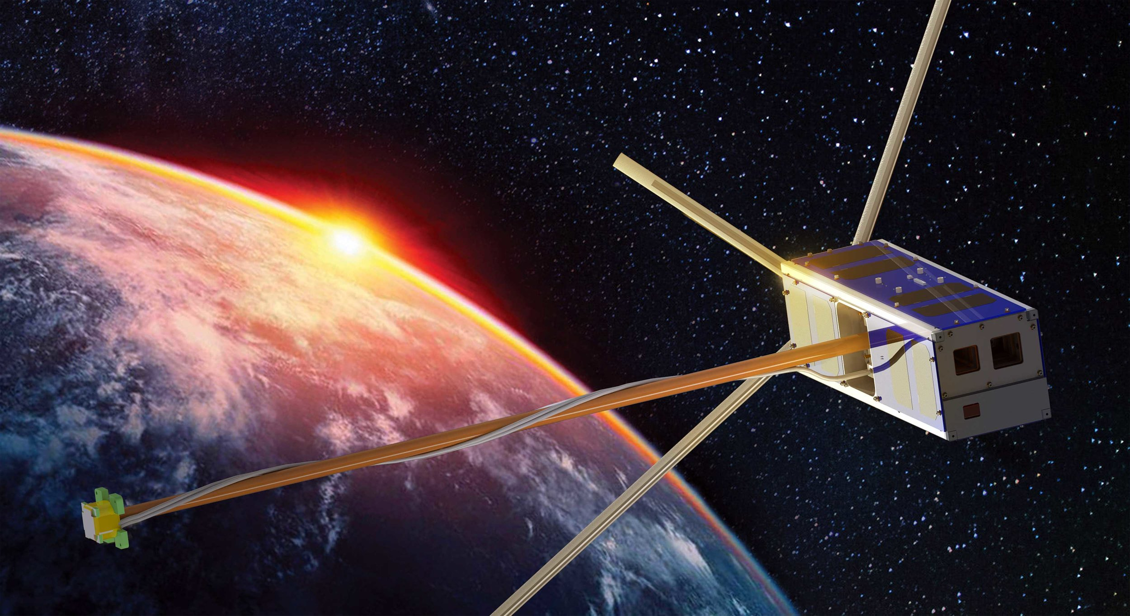
ELFIN - A
A
**Note: I ordered ELFIN-A spectrograms showing electron-flux first then ion-flux because they both cover the exact same time period, so that way, you can make a quick glance of a comparison between the e-flux and ion-flux.

Slide 6
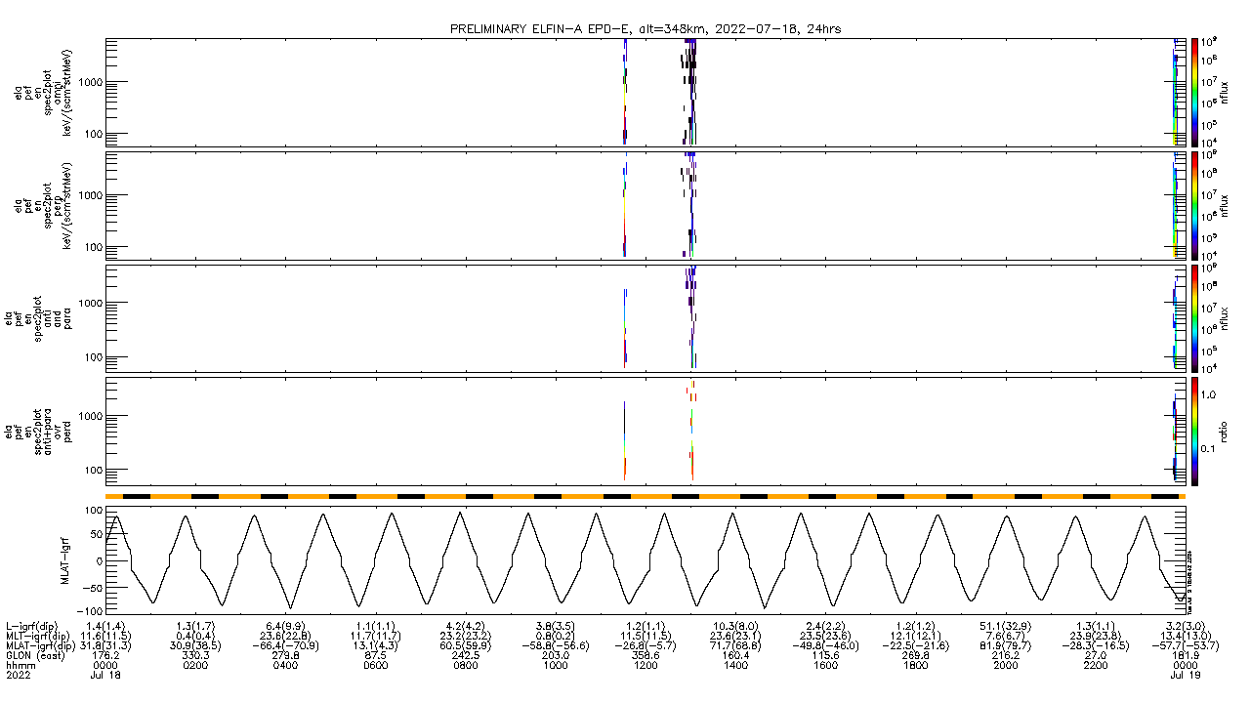
7/18/2022 (24hr)
Energetic Particle Detector for electrons
ELFIN-A, Electron-Flux, alt=348km
J_{OMNI}
keV/(cm²/sr/s/MeV)
e-flux
J_{ꓕ}
keV/(cm²/sr/s/MeV)
e-flux
J_{anti+para}
keV/(cm²/sr/s/MeV)
e-flux
J_{prec} / J_{ꓕ}
keV/(cm²/sr/s/MeV)
ratio
Sun / Shadow
MLAT

Slide 7
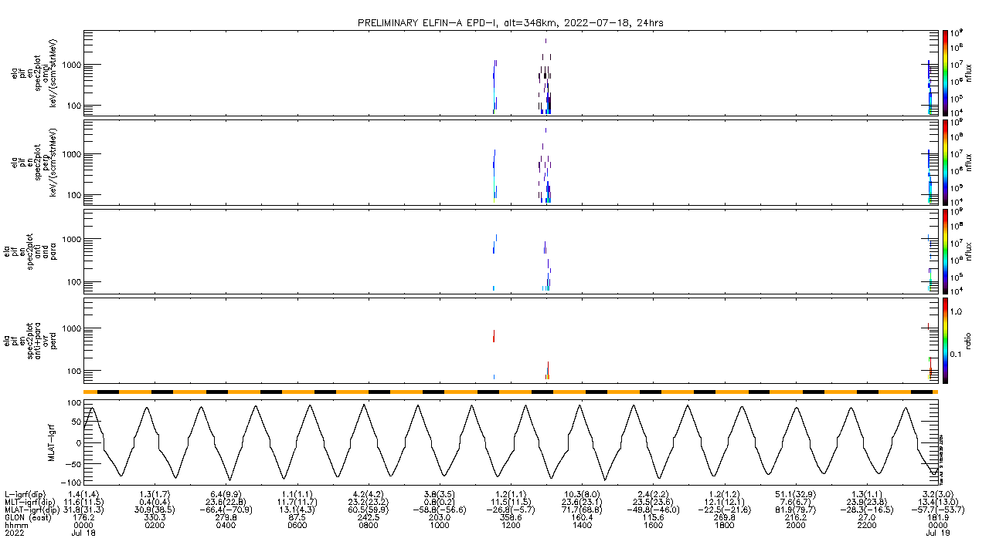
7/18/2022 (24hr)
Energetic Particle Detector for ions
ELFIN-A, Ion-Flux, alt=348km
J_{OMNI}
keV/(cm²/sr/s/MeV)
i-flux
J_{ꓕ}
keV/(cm²/sr/s/MeV)
i-flux
J_{anti+para}
keV/(cm²/sr/s/MeV)
i-flux
J_{prec} / J_{ꓕ}
keV/(cm²/sr/s/MeV)
ratio
Sun / Shadow
MLAT

Slide 8
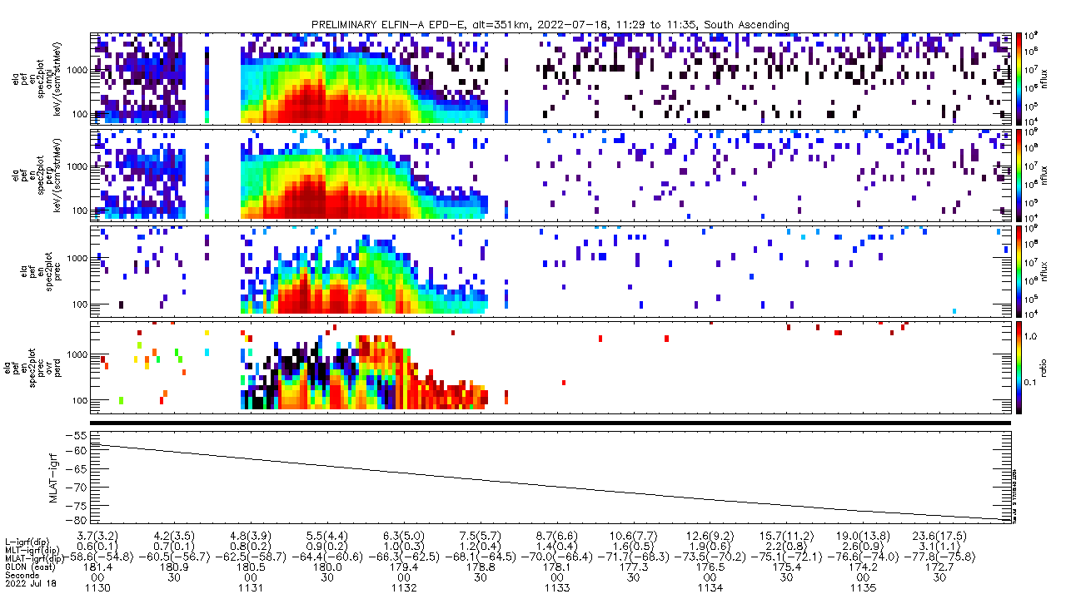
7/18/2022 (11:29:57 – 11:35:58 UTC)
Energetic Particle Detector for electrons
ELFIN-A, Electron-Flux, alt=351km, South Ascending
J_{OMNI}
keV/(cm²/sr/s/MeV)
e-flux
J_{ꓕ}
keV/(cm²/sr/s/MeV)
e-flux
J_{prec}
keV/(cm²/sr/s/MeV)
e-flux
J_{prec} / J_{ꓕ}
keV/(cm²/sr/s/MeV)
ratio
Sun / Shadow
MLAT

Slide 9
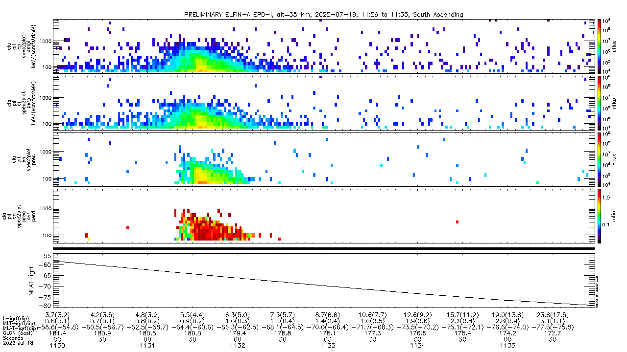
7/18/2022 (11:29:57 – 11:35:58 UTC)
Energetic Particle Detector for ions
ELFIN-A, Ion-Flux, alt=351km, South Ascending
J_{OMNI}
keV/(cm²/sr/s/MeV)
i-flux
J_{ꓕ}
keV/(cm²/sr/s/MeV)
i-flux
J_{prec}
keV/(cm²/sr/s/MeV)
i-flux
J_{prec} / J_{ꓕ}
keV/(cm²/sr/s/MeV)
ratio
Sun / Shadow
MLAT

Slide 10
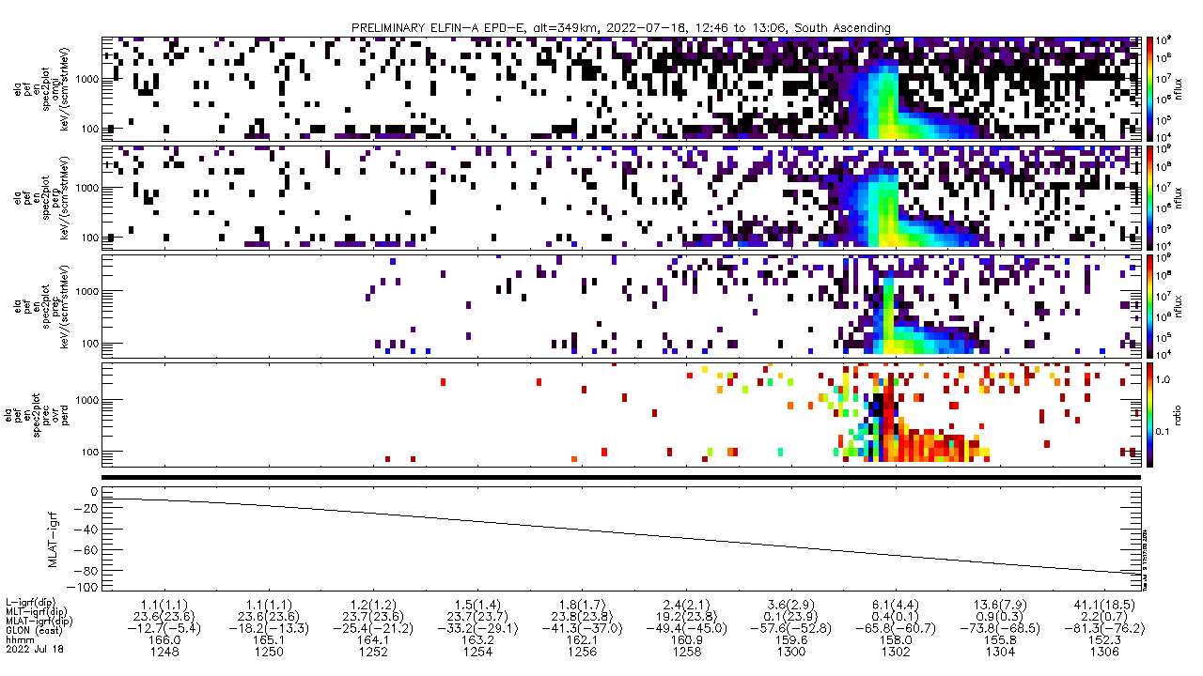
7/18/2022 (12:46:48 – 13:06:42 UTC)
Energetic Particle Detector for electrons
ELFIN-A, Electron-Flux, alt=349km, South Ascending
J_{OMNI}
keV/(cm²/sr/s/MeV)
e-flux
J_{ꓕ}
keV/(cm²/sr/s/MeV)
e-flux
J_{prec}
keV/(cm²/sr/s/MeV)
e-flux
J_{prec} / J_{ꓕ}
keV/(cm²/sr/s/MeV)
ratio
Sun / Shadow
MLAT

Slide 11
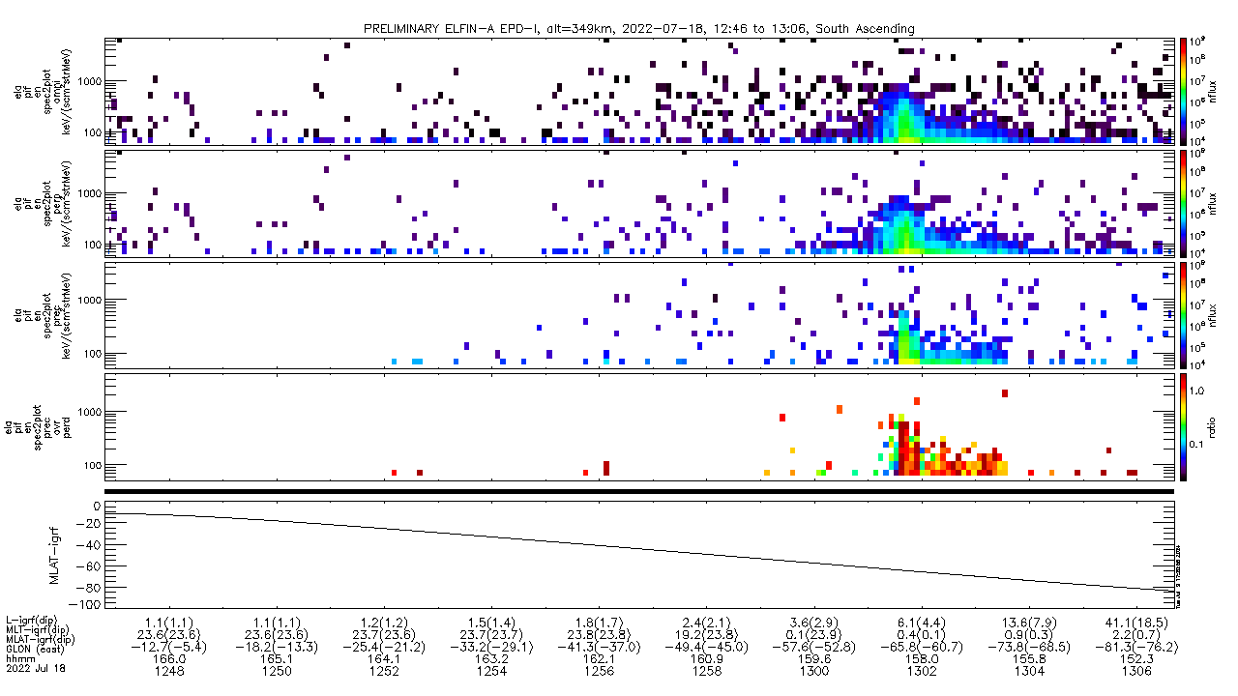
7/18/2022 (12:46:48 – 13:06:42 UTC)
Energetic Particle Detector for ions
ELFIN-A, Ion-Flux, alt=349km, South Ascending
J_{OMNI}
keV/(cm²/sr/s/MeV)
i-flux
J_{ꓕ}
keV/(cm²/sr/s/MeV)
i-flux
J_{prec}
keV/(cm²/sr/s/MeV)
i-flux
J_{prec} / J_{ꓕ}
keV/(cm²/sr/s/MeV)
ratio
Sun / Shadow
MLAT

Slide 12
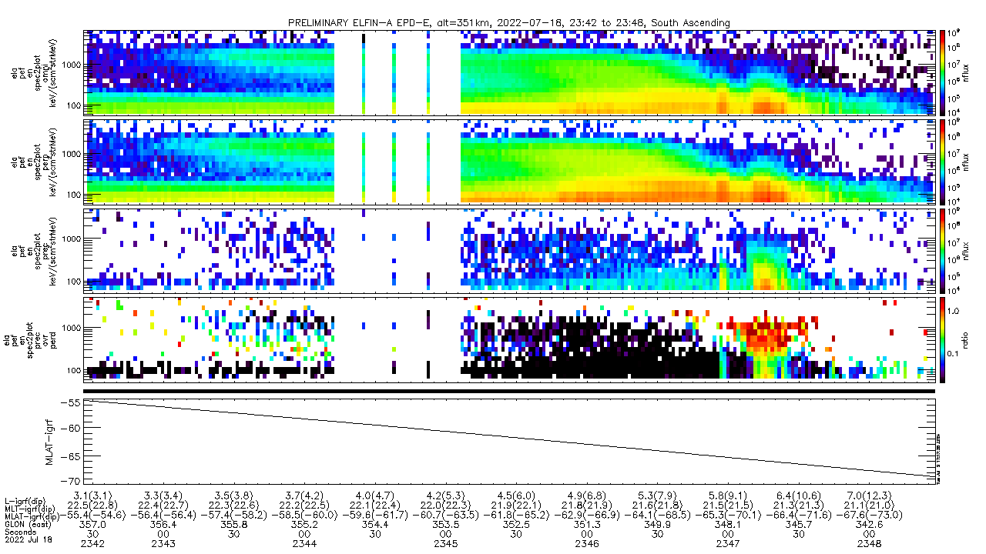
7/18/2022 (23:42:26 – 23:48:28 UTC)
Energetic Particle Detector for electrons
ELFIN-A, Electron-Flux, alt=351km, South Ascending
J_{OMNI}
keV/(cm²/sr/s/MeV)
e-flux
J_{ꓕ}
keV/(cm²/sr/s/MeV)
e-flux
J_{prec}
keV/(cm²/sr/s/MeV)
e-flux
J_{prec} / J_{ꓕ}
keV/(cm²/sr/s/MeV)
ratio
Sun / Shadow
MLAT

Slide 13
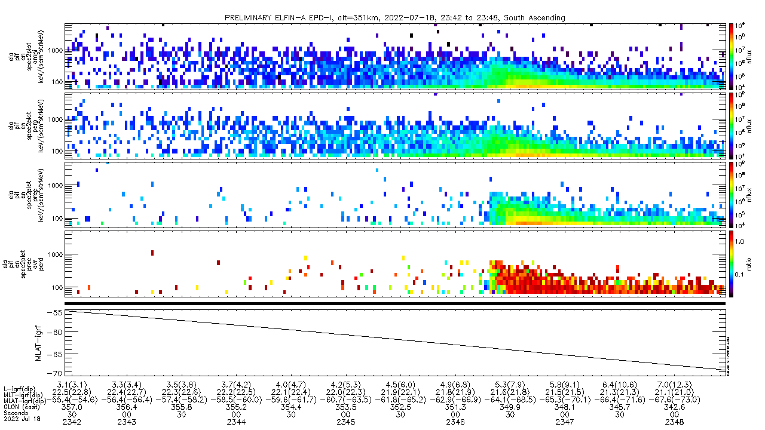
7/18/2022 (23:42:26 – 23:48:28 UTC)
Energetic Particle Detector for ions
ELFIN-A, Ion-Flux, alt=351km, South Ascending
J_{OMNI}
keV/(cm²/sr/s/MeV)
i-flux
J_{ꓕ}
keV/(cm²/sr/s/MeV)
i-flux
J_{prec}
keV/(cm²/sr/s/MeV)
i-flux
J_{prec} / J_{ꓕ}
keV/(cm²/sr/s/MeV)
ratio
Sun / Shadow
MLAT

Slide 14
7/18/2022 (24hr)
Energetic Particle Detector for electrons/ions
[missing 2022-07-18 ELFIN-B data]

Slide 15
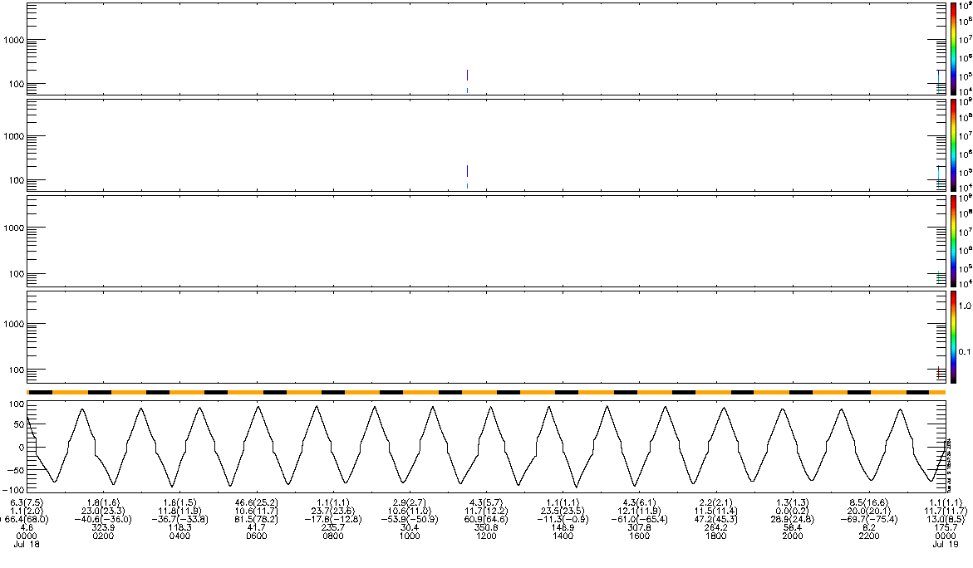
7/18/2022 (24hr)
Energetic Particle Detector for ions
ELFIN-B, Ion-Flux, alt=358km
J_{OMNI}
keV/(cm²/sr/s/MeV)
i-flux
[BAD COVERAGE]
J_{ꓕ}
keV/(cm²/sr/s/MeV)
i-flux
J_{prec}
keV/(cm²/sr/s/MeV)
i-flux
J_{prec} / J_{ꓕ}
keV/(cm²/sr/s/MeV)
ratio
MLAT

Slide 16
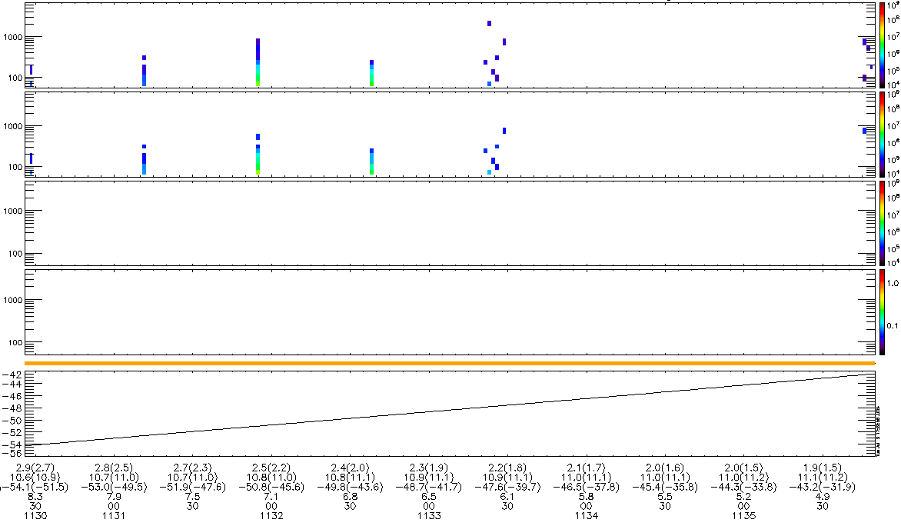
7/18/2022 (11:30:26 – 11:35:50 UTC)
Energetic Particle Detector for ions
ELFIN-B, Ion-Flux, alt=365km, North Descending
J_{OMNI}
keV/(cm²/sr/s/MeV)
i-flux
[BAD COVERAGE]
J_{ꓕ}
keV/(cm²/sr/s/MeV)
i-flux
J_{prec}
keV/(cm²/sr/s/MeV)
i-flux
J_{prec} / J_{ꓕ}
keV/(cm²/sr/s/MeV)
ratio
MLAT

Slide 17
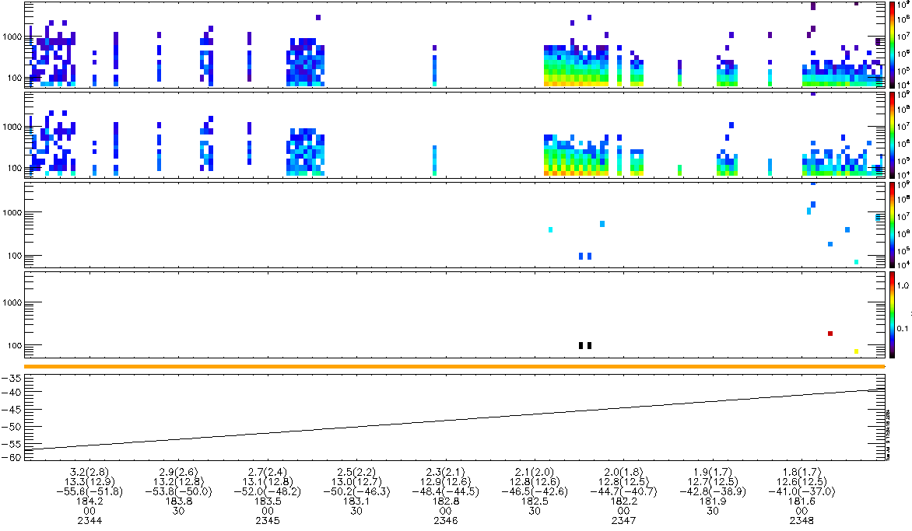
7/18/2022 (23:43:38 – 23:48:28 UTC)
Energetic Particle Detector for ions
ELFIN-B, Ion-Flux, alt=365km, North Descending
J_{OMNI}
keV/(cm²/sr/s/MeV)
i-flux
[BAD COVERAGE]
J_{ꓕ}
keV/(cm²/sr/s/MeV)
i-flux
J_{prec}
keV/(cm²/sr/s/MeV)
i-flux
J_{prec} / J_{ꓕ}
keV/(cm²/sr/s/MeV)
ratio
MLAT

Slide 18
7/19/2022

Slide 19
ELFIN - A
A
**Note: I ordered ELFIN-A spectrograms showing electron-flux first then ion-flux because they both cover the exact same time period, so that way, you can make a quick glance of a comparison between the e-flux and ion-flux.

Slide 20
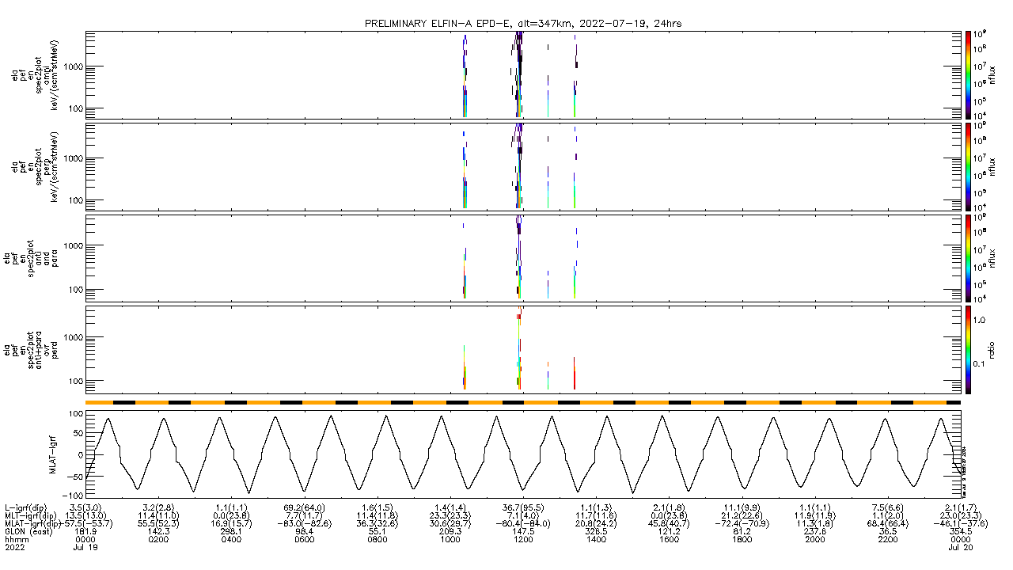
7/19/2022 (24hr)
Energetic Particle Detector for electrons
ELFIN-A, Electron-Flux, alt=347km
J_{OMNI}
keV/(cm²/sr/s/MeV)
e-flux
J_{ꓕ}
keV/(cm²/sr/s/MeV)
e-flux
J_{anti+para}
keV/(cm²/sr/s/MeV)
e-flux
J_{prec} / J_{ꓕ}
keV/(cm²/sr/s/MeV)
ratio
Sun / Shadow
MLAT

Slide 21
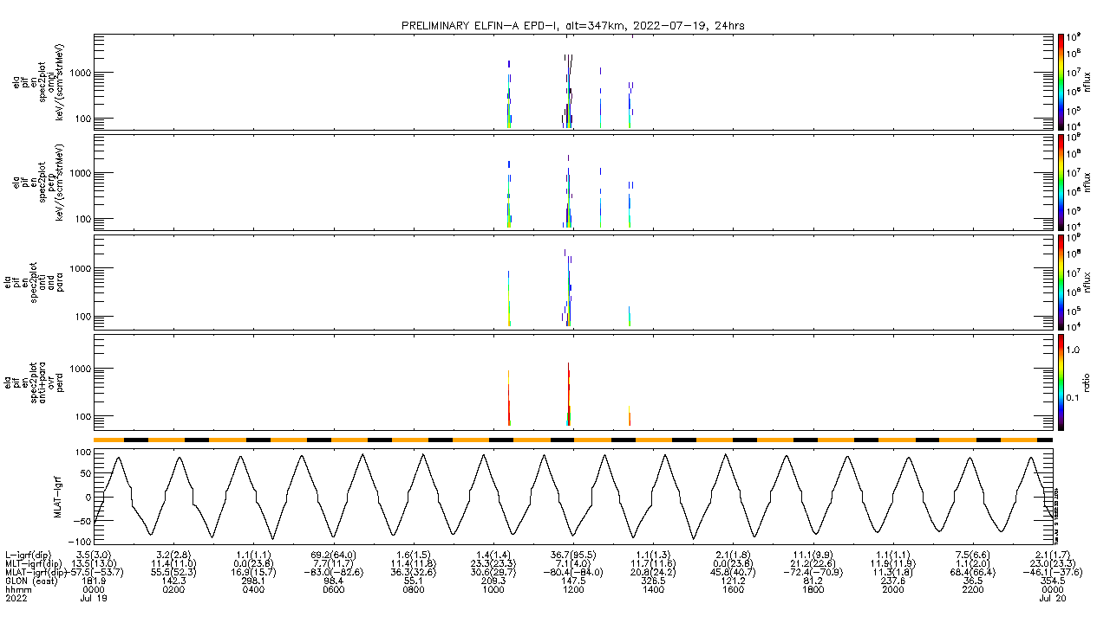
7/19/2022 (24hr)
Energetic Particle Detector for ions
ELFIN-A, Ion-Flux, alt=347km
J_{OMNI}
keV/(cm²/sr/s/MeV)
i-flux
J_{ꓕ}
keV/(cm²/sr/s/MeV)
i-flux
J_{anti+para}
keV/(cm²/sr/s/MeV)
i-flux
J_{prec} / J_{ꓕ}
keV/(cm²/sr/s/MeV)
ratio
Sun / Shadow
MLAT

Slide 22
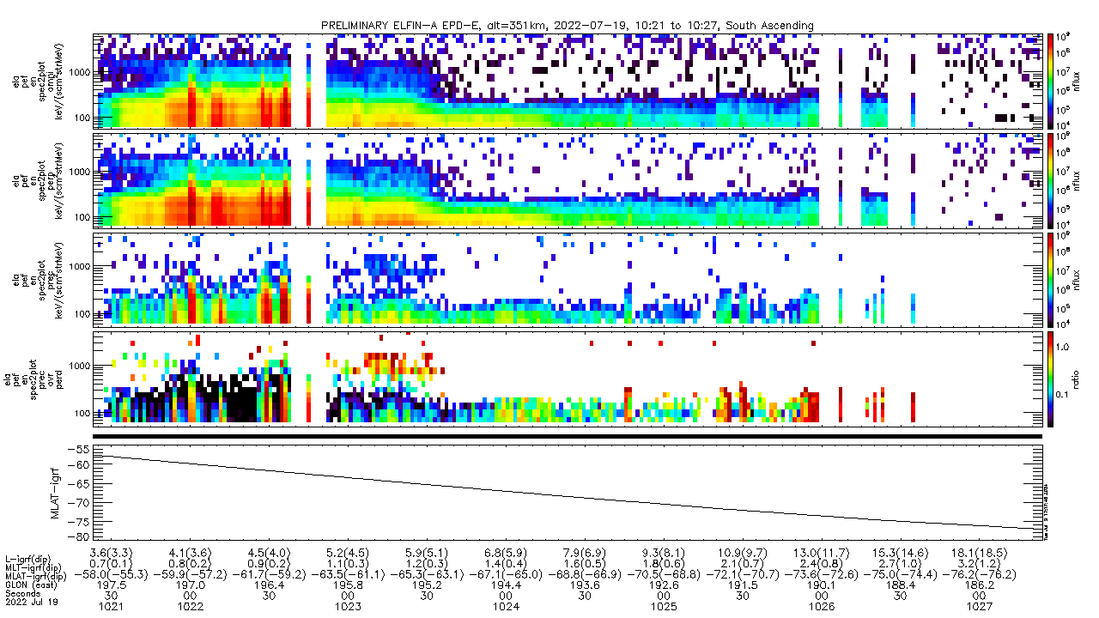
7/19/2022 (10:21:23 – 10:27:24 UTC)
Energetic Particle Detector for electrons
ELFIN-A, Electron-Flux, alt=351km, South Ascending
J_{OMNI}
keV/(cm²/sr/s/MeV)
e-flux
J_{ꓕ}
keV/(cm²/sr/s/MeV)
e-flux
J_{prec}
keV/(cm²/sr/s/MeV)
e-flux
J_{prec} / J_{ꓕ}
keV/(cm²/sr/s/MeV)
ratio
Sun / Shadow
MLAT

Slide 23
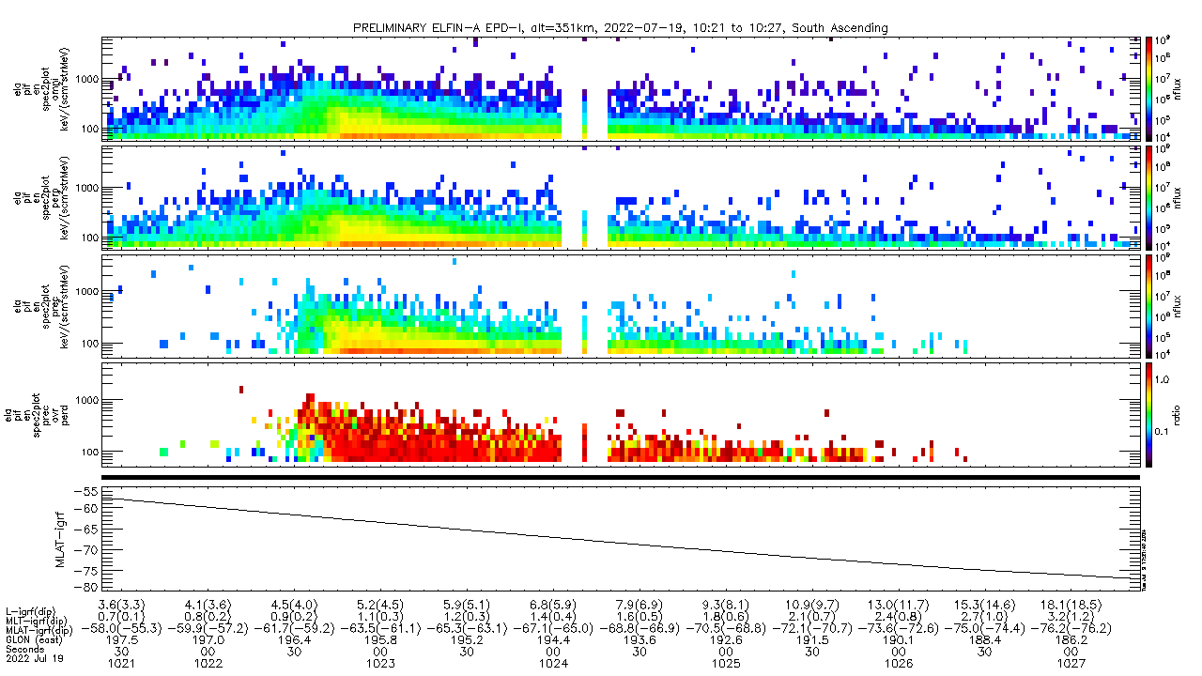
7/19/2022 (10:21:23 – 10:27:24 UTC)
Energetic Particle Detector for ions
ELFIN-A, Ion-Flux, alt=351km, South Ascending
J_{OMNI}
keV/(cm²/sr/s/MeV)
i-flux
J_{ꓕ}
keV/(cm²/sr/s/MeV)
i-flux
J_{prec}
keV/(cm²/sr/s/MeV)
i-flux
J_{prec} / J_{ꓕ}
keV/(cm²/sr/s/MeV)
ratio
Sun / Shadow
MLAT

Slide 24
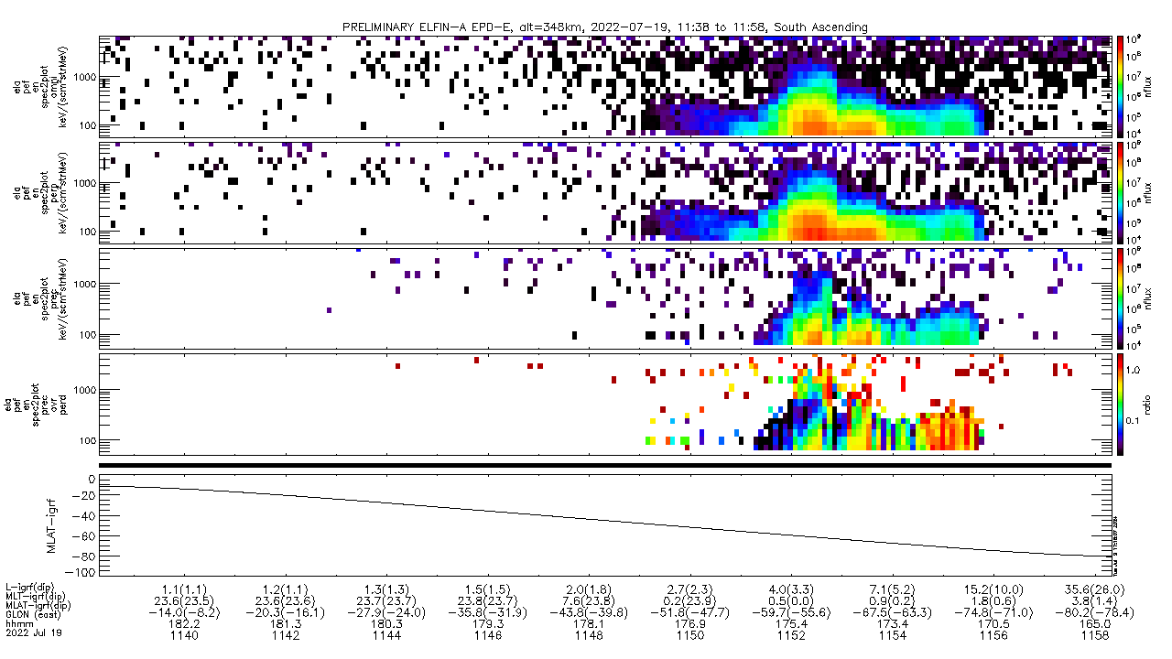
7/19/2022 (11:38:19 – 11:58:20 UTC)
Energetic Particle Detector for electrons
ELFIN-A, Electron-Flux, alt=348km, South Ascending
J_{OMNI}
keV/(cm²/sr/s/MeV)
e-flux
J_{ꓕ}
keV/(cm²/sr/s/MeV)
e-flux
J_{prec}
keV/(cm²/sr/s/MeV)
e-flux
J_{prec} / J_{ꓕ}
keV/(cm²/sr/s/MeV)
ratio
Sun / Shadow
MLAT

Slide 25
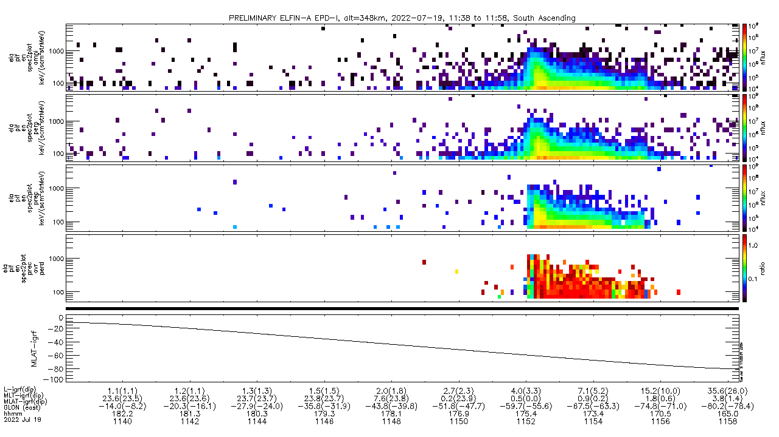
7/19/2022 (11:38:19 – 11:58:20 UTC)
Energetic Particle Detector for ions
ELFIN-A, Ion-Flux, alt=348km, South Ascending
J_{OMNI}
keV/(cm²/sr/s/MeV)
i-flux
J_{ꓕ}
keV/(cm²/sr/s/MeV)
i-flux
J_{prec}
keV/(cm²/sr/s/MeV)
i-flux
J_{prec} / J_{ꓕ}
keV/(cm²/sr/s/MeV)
ratio
Sun / Shadow
MLAT

Slide 26
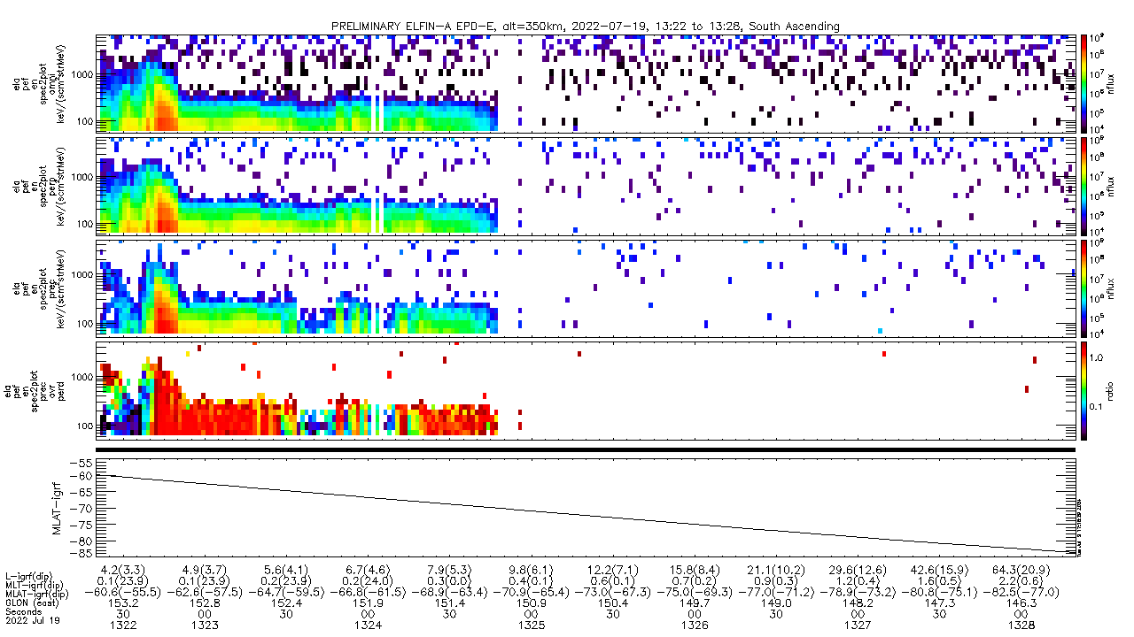
7/19/2022 (13:22:20 – 13:28:20 UTC)
Energetic Particle Detector for electrons
ELFIN-A, Electron-Flux, alt=350km, South Ascending
J_{OMNI}
keV/(cm²/sr/s/MeV)
e-flux
J_{ꓕ}
keV/(cm²/sr/s/MeV)
e-flux
J_{prec}
keV/(cm²/sr/s/MeV)
e-flux
J_{prec} / J_{ꓕ}
keV/(cm²/sr/s/MeV)
ratio
Sun / Shadow
MLAT

Slide 27
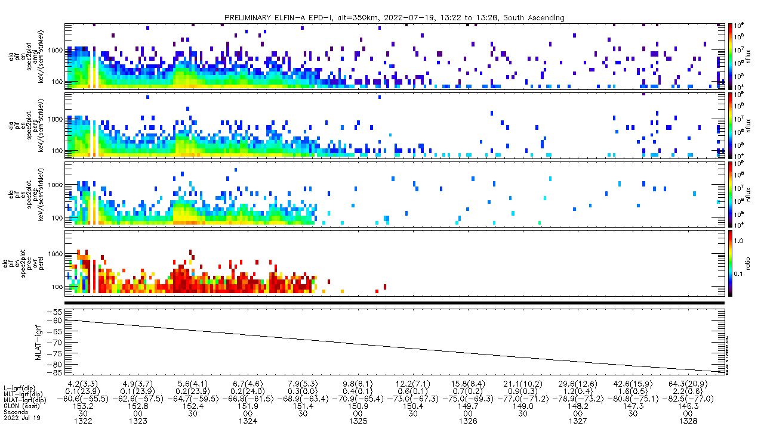
7/19/2022 (13:22:20 – 13:28:20 UTC)
Energetic Particle Detector for ions
ELFIN-A, Ion-Flux, alt=350km, South Ascending
J_{OMNI}
keV/(cm²/sr/s/MeV)
i-flux
J_{ꓕ}
keV/(cm²/sr/s/MeV)
i-flux
J_{prec}
keV/(cm²/sr/s/MeV)
i-flux
J_{prec} / J_{ꓕ}
keV/(cm²/sr/s/MeV)
ratio
Sun / Shadow
MLAT

Slide 28
ELFIN - B
B/STAR
**Note: I ordered ELFIN-B spectrograms showing electron-flux first then ion-flux because they both cover the exact same time period, so that way, you can make a quick glance of a comparison between the e-flux and ion-flux.

Slide 29
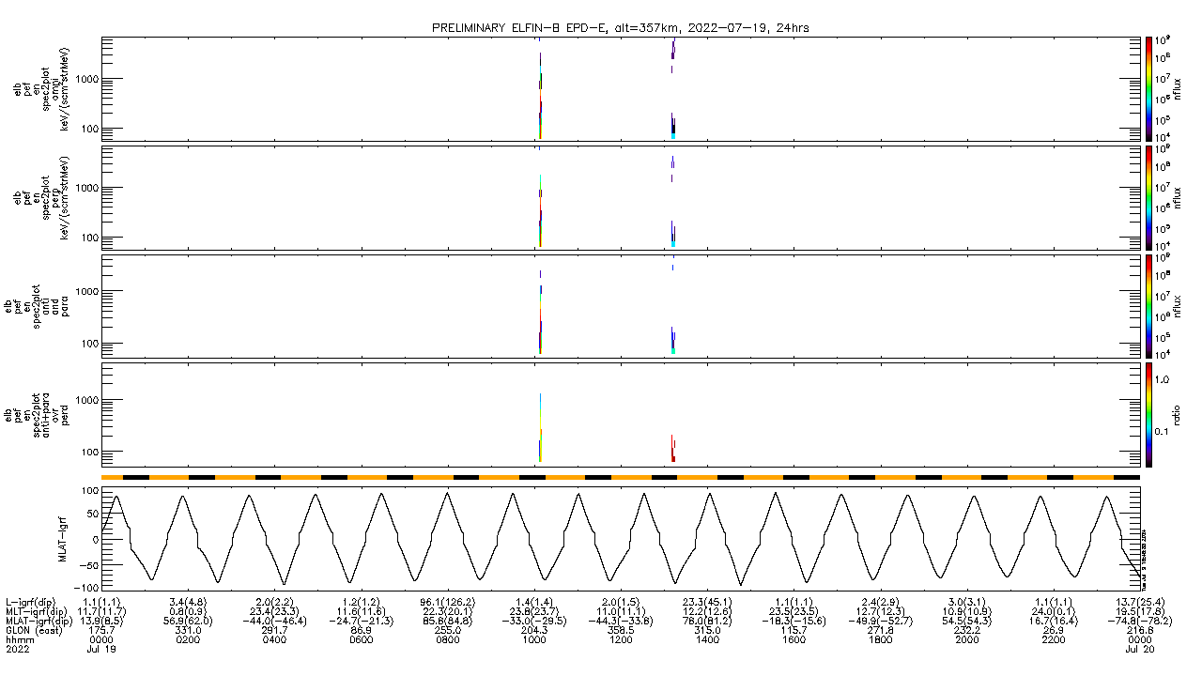
7/19/2022 (24hr)
Energetic Particle Detector for electrons
ELFIN-B, Electron-Flux, alt=357km
J_{OMNI}
keV/(cm²/sr/s/MeV)
e-flux
J_{ꓕ}
keV/(cm²/sr/s/MeV)
e-flux
J_{anti+para}
keV/(cm²/sr/s/MeV)
e-flux
J_{prec} / J_{ꓕ}
keV/(cm²/sr/s/MeV)
ratio
Sun / Shadow
MLAT

Slide 30
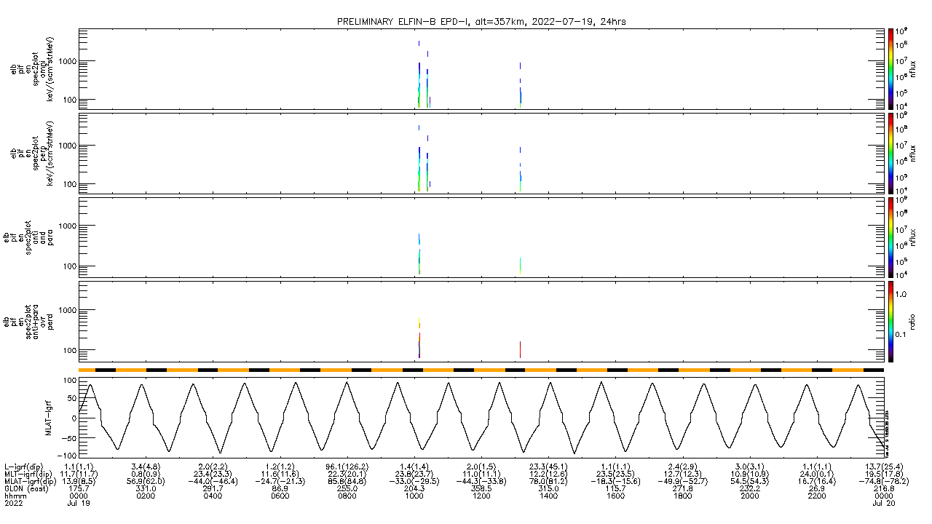
7/19/2022 (24hr)
Energetic Particle Detector for ions
ELFIN-B, Ion-Flux, alt=357km
J_{OMNI}
keV/(cm²/sr/s/MeV)
i-flux
J_{ꓕ}
keV/(cm²/sr/s/MeV)
i-flux
J_{anti+para}
keV/(cm²/sr/s/MeV)
i-flux
J_{prec} / J_{ꓕ}
keV/(cm²/sr/s/MeV)
ratio
Sun / Shadow
MLAT

Slide 31
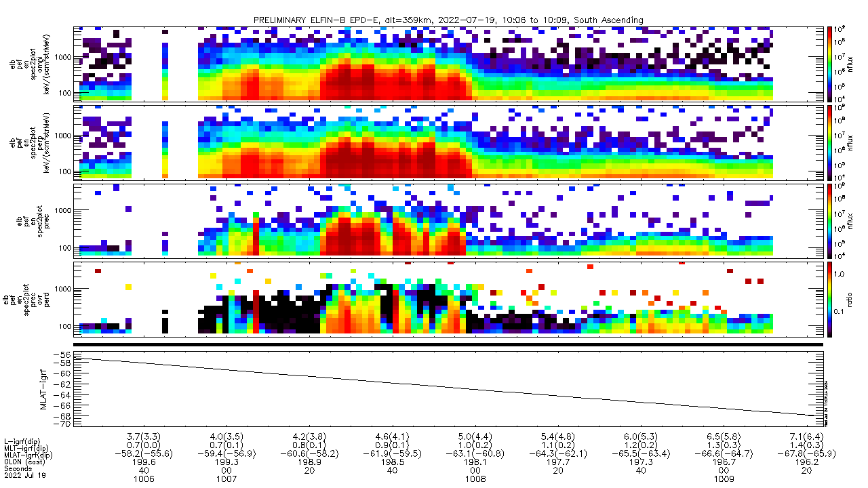
7/19/2022 (10:06:23 – 10:09:24 UTC)
Energetic Particle Detector for electrons
ELFIN-B, Electron-Flux, alt=359km, South Ascending
J_{OMNI}
keV/(cm²/sr/s/MeV)
e-flux
J_{ꓕ}
keV/(cm²/sr/s/MeV)
e-flux
J_{prec}
keV/(cm²/sr/s/MeV)
e-flux
J_{prec} / J_{ꓕ}
keV/(cm²/sr/s/MeV)
ratio
Sun / Shadow
MLAT

Slide 32
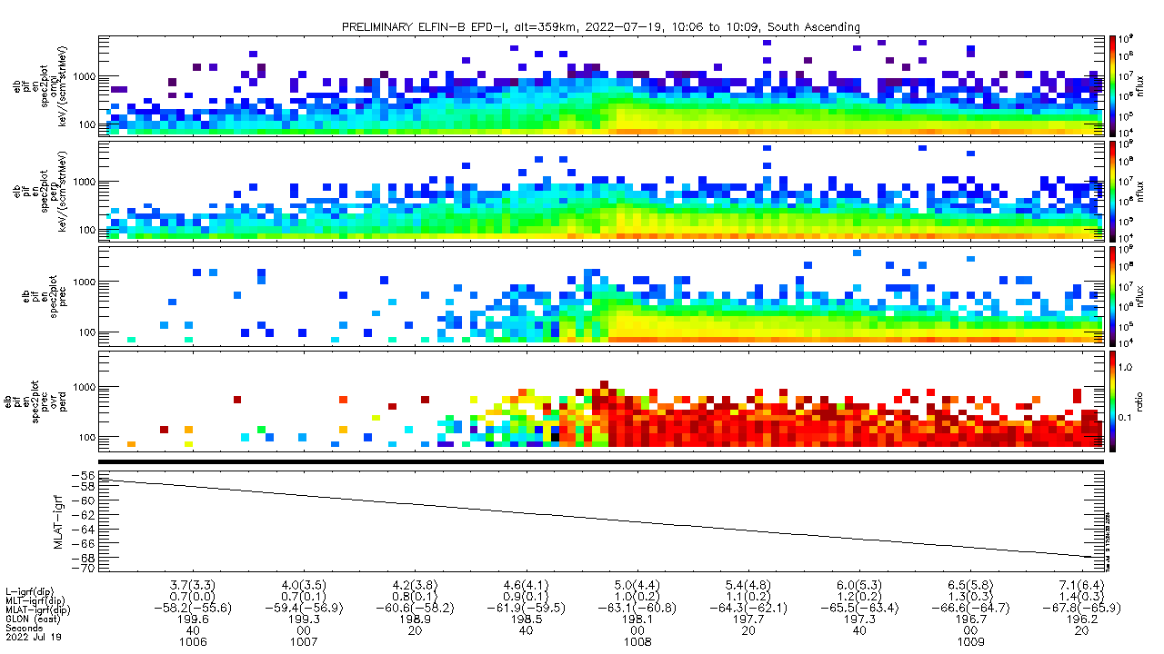
7/19/2022 (10:06:23 – 10:09:24 UTC)
Energetic Particle Detector for electrons
ELFIN-B, Ion-Flux, alt=359km, South Ascending
J_{OMNI}
keV/(cm²/sr/s/MeV)
i-flux
J_{ꓕ}
keV/(cm²/sr/s/MeV)
i-flux
J_{prec}
keV/(cm²/sr/s/MeV)
i-flux
J_{prec} / J_{ꓕ}
keV/(cm²/sr/s/MeV)
ratio
Sun / Shadow
MLAT

Slide 33
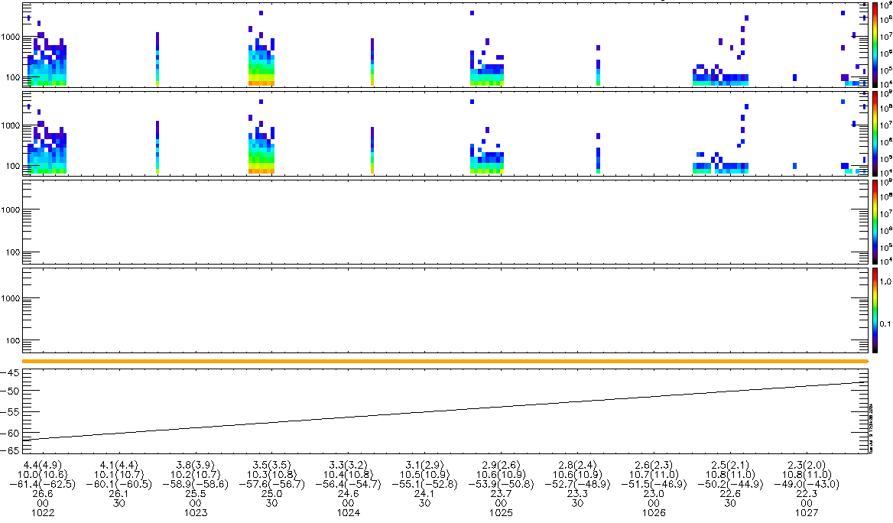
7/19/2022 (10:21:52 – 10:27:24 UTC)
Energetic Particle Detector for electrons
ELFIN-B, Ion-Flux, alt=364km, North Descending
J_{OMNI}
keV/(cm²/sr/s/MeV)
i-flux
[BAD COVERAGE]
J_{ꓕ}
keV/(cm²/sr/s/MeV)
i-flux
J_{prec}
keV/(cm²/sr/s/MeV)
i-flux
J_{prec} / J_{ꓕ}
keV/(cm²/sr/s/MeV)
ratio
MLAT

Slide 34
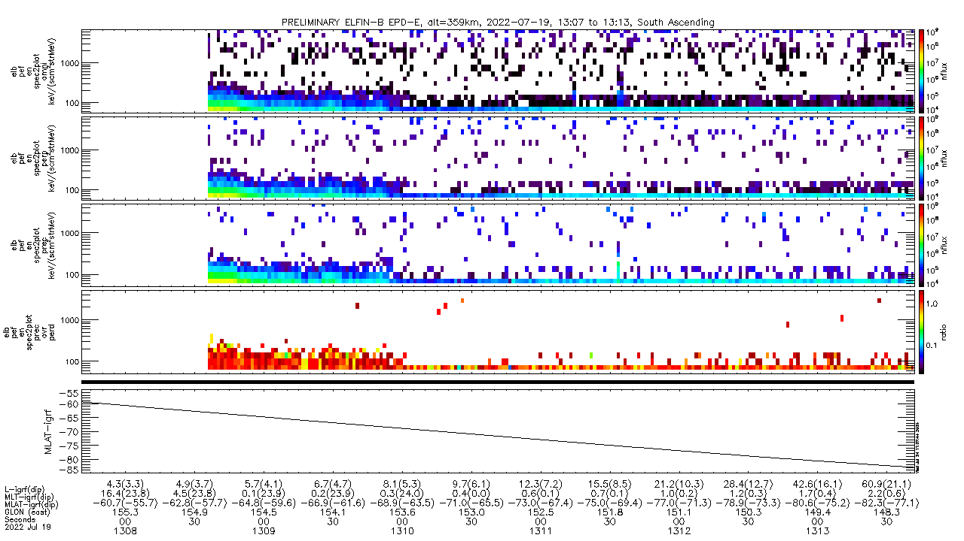
7/19/2022 (13:07:41 – 13:13:42 UTC)
Energetic Particle Detector for electrons
ELFIN-B, Electron-Flux, alt=359km, South Ascending
J_{OMNI}
keV/(cm²/sr/s/MeV)
e-flux
J_{ꓕ}
keV/(cm²/sr/s/MeV)
e-flux
J_{prec}
keV/(cm²/sr/s/MeV)
e-flux
J_{prec} / J_{ꓕ}
keV/(cm²/sr/s/MeV)
ratio
Sun / Shadow
MLAT

Slide 35
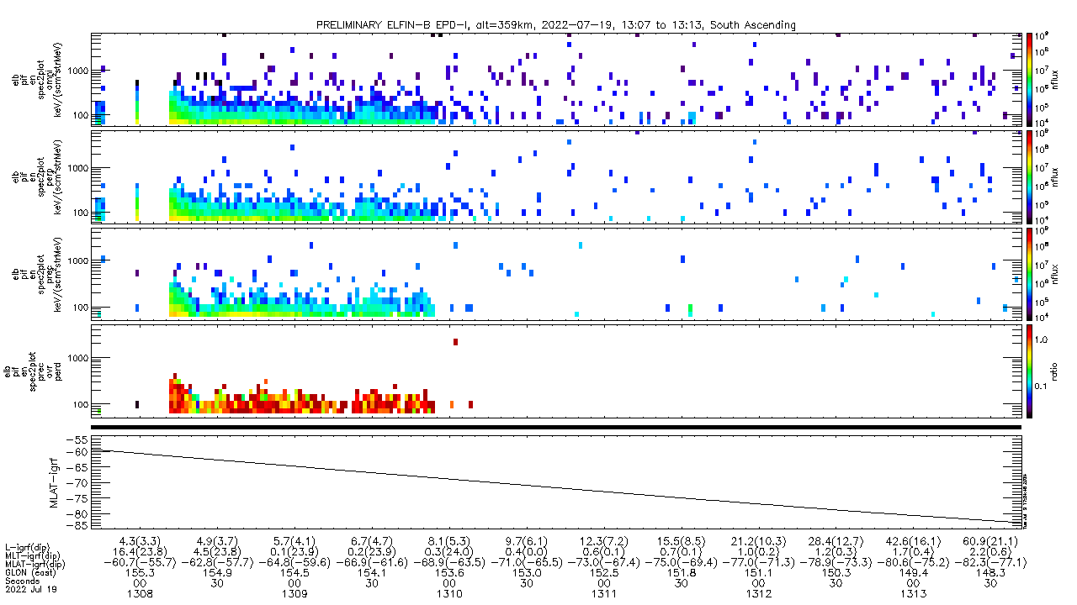
7/19/2022 (13:07:41 – 13:13:42 UTC)
Energetic Particle Detector for electrons
ELFIN-B, Ion-Flux, alt=359km, South Ascending
J_{OMNI}
keV/(cm²/sr/s/MeV)
i-flux
J_{ꓕ}
keV/(cm²/sr/s/MeV)
i-flux
J_{prec}
keV/(cm²/sr/s/MeV)
i-flux
J_{prec} / J_{ꓕ}
keV/(cm²/sr/s/MeV)
ratio
Sun / Shadow
MLAT

Slide 36
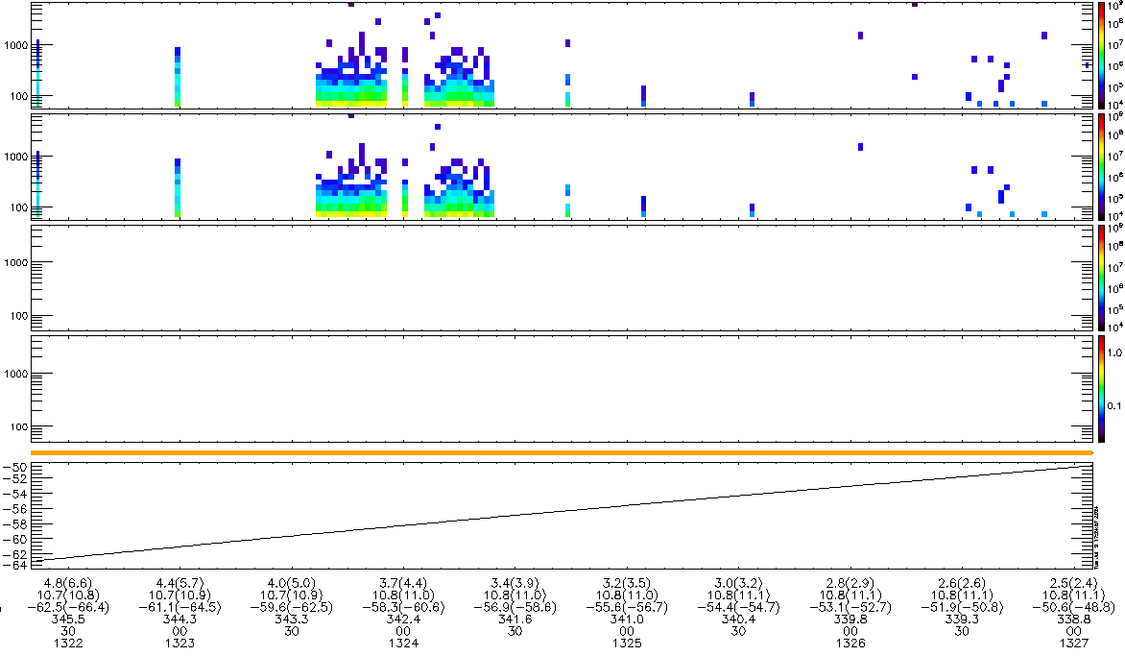
7/19/2022 (13:22:20 – 13:27:05 UTC)
Energetic Particle Detector for electrons
ELFIN-B, Ion-Flux, alt=363km, North Descending
J_{OMNI}
keV/(cm²/sr/s/MeV)
i-flux
[BAD COVERAGE]
J_{ꓕ}
keV/(cm²/sr/s/MeV)
i-flux
J_{prec}
keV/(cm²/sr/s/MeV)
i-flux
J_{prec} / J_{ꓕ}
keV/(cm²/sr/s/MeV)
ratio
MLAT

Slide 37
ELFIN-A vs B
A vs B
**Note: I paired the ELFIN-A e-flux spectrograms which are close in time (within 30 minutes of each other) and position (within +/-10 MLAT of each other) with the ELFIN-B e-flux spectrograms. I did the same pairing with ELFIN-A ion-flux and ELFIN-B ion-flux spectrograms

Slide 38
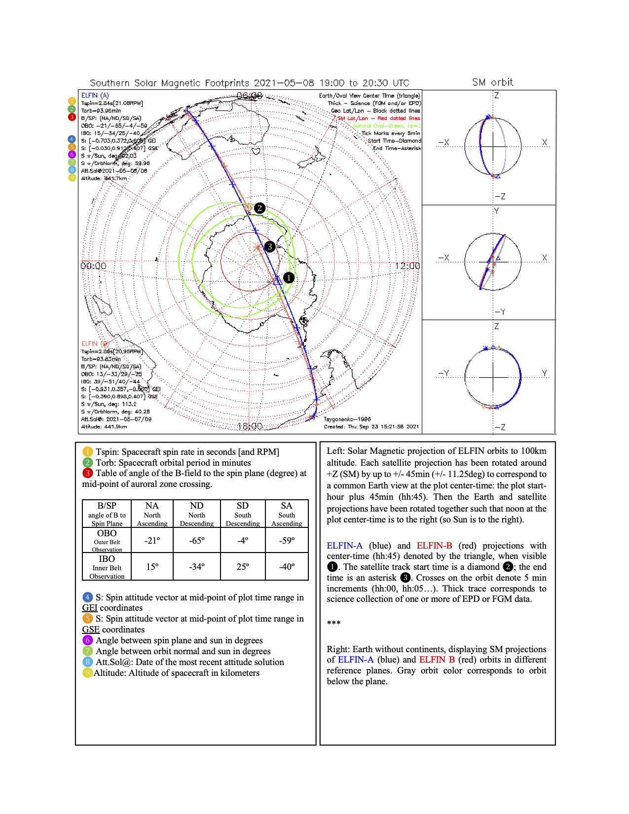
How to Read Map
I want to show the times where ELFIN-A and ELFIN-B are close in time and position and capture data over the same rough area.
ELFIN-B START
ELFIN-A
HALFWAY
ELFIN-B END

Slide 39
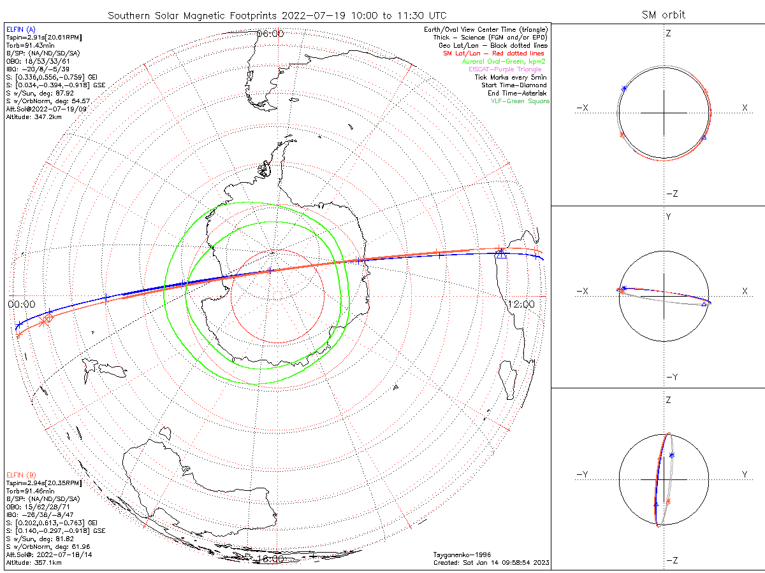
ELFIN-A (10:21:23 – 10:27:24 UTC)*
ELFIN-B (10:06:23 – 10:09:24 UTC)*
*The ranges I drew are rough estimations and are not pixel-perfect accurate

Slide 40
7/19/2022 (10:06:23 – 10:09:24 UTC)
Energetic Particle Detector for electrons
ELFIN-B, Electron-Flux, alt=359km, South Ascending
J_{OMNI}
keV/(cm²/sr/s/MeV)
e-flux
J_{ꓕ}
keV/(cm²/sr/s/MeV)
e-flux
J_{prec}
keV/(cm²/sr/s/MeV)
e-flux
J_{prec} / J_{ꓕ}
keV/(cm²/sr/s/MeV)
ratio
Sun / Shadow
MLAT

Slide 41
7/19/2022 (10:21:23 – 10:27:24 UTC)
Energetic Particle Detector for electrons
ELFIN-A, Electron-Flux, alt=351km, South Ascending
J_{OMNI}
keV/(cm²/sr/s/MeV)
e-flux
J_{ꓕ}
keV/(cm²/sr/s/MeV)
e-flux
J_{prec}
keV/(cm²/sr/s/MeV)
e-flux
J_{prec} / J_{ꓕ}
keV/(cm²/sr/s/MeV)
ratio
Sun / Shadow
MLAT

Slide 42
7/19/2022 (10:06:23 – 10:09:24 UTC)
Energetic Particle Detector for electrons
ELFIN-B, Ion-Flux, alt=359km, South Ascending
J_{OMNI}
keV/(cm²/sr/s/MeV)
i-flux
J_{ꓕ}
keV/(cm²/sr/s/MeV)
i-flux
J_{prec}
keV/(cm²/sr/s/MeV)
i-flux
J_{prec} / J_{ꓕ}
keV/(cm²/sr/s/MeV)
ratio
Sun / Shadow
MLAT

Slide 43
7/19/2022 (10:21:23 – 10:27:24 UTC)
Energetic Particle Detector for ions
ELFIN-A, Ion-Flux, alt=351km, South Ascending
J_{OMNI}
keV/(cm²/sr/s/MeV)
i-flux
J_{ꓕ}
keV/(cm²/sr/s/MeV)
i-flux
J_{prec}
keV/(cm²/sr/s/MeV)
i-flux
J_{prec} / J_{ꓕ}
keV/(cm²/sr/s/MeV)
ratio
Sun / Shadow
MLAT

Slide 44
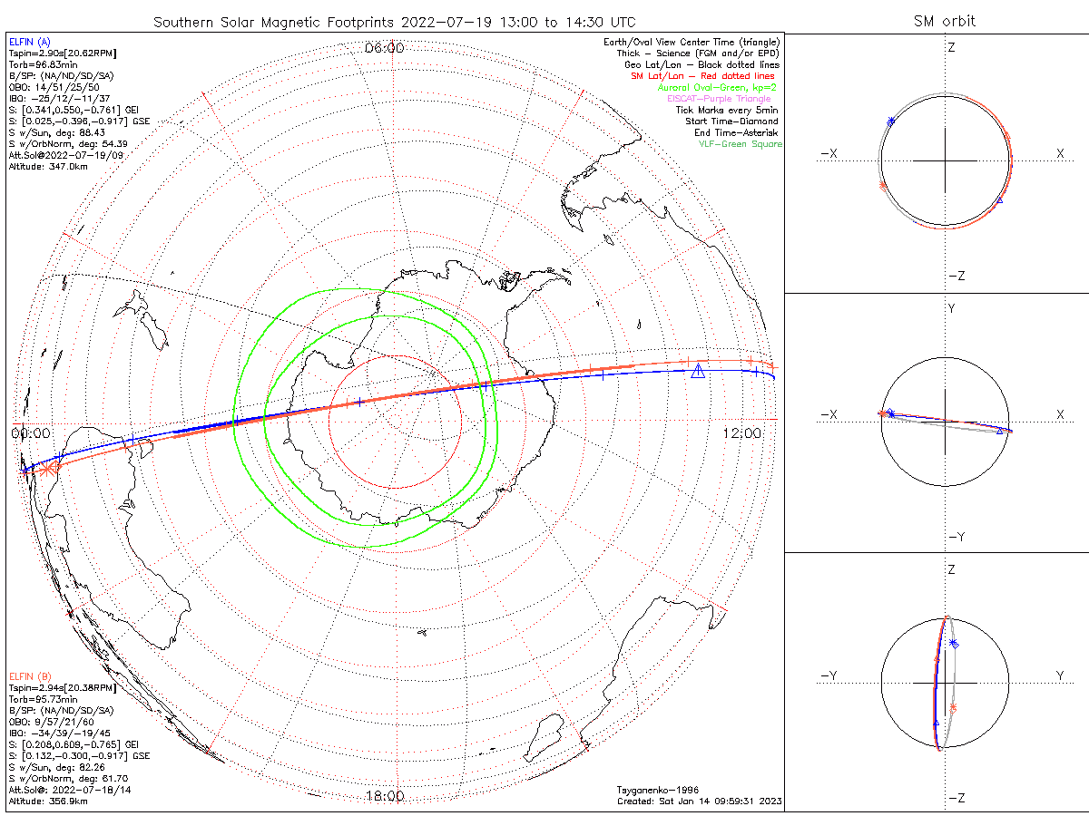
ELFIN-A (13:22:20 – 13:28:20 UTC)*
ELFIN-B (13:07:41 – 13:13:42 UTC)*
*The ranges I drew are rough estimations and are not pixel-perfect accurate

Slide 45
7/19/2022 (13:22:20 – 13:28:20 UTC)
Energetic Particle Detector for electrons
ELFIN-A, Electron-Flux, alt=350km, South Ascending
J_{OMNI}
keV/(cm²/sr/s/MeV)
e-flux
J_{ꓕ}
keV/(cm²/sr/s/MeV)
e-flux
J_{prec}
keV/(cm²/sr/s/MeV)
e-flux
J_{prec} / J_{ꓕ}
keV/(cm²/sr/s/MeV)
ratio
Sun / Shadow
MLAT

Slide 46
7/19/2022 (13:07:41 – 13:13:42 UTC)
Energetic Particle Detector for electrons
ELFIN-B, Electron-Flux, alt=359km, South Ascending
J_{OMNI}
keV/(cm²/sr/s/MeV)
e-flux
J_{ꓕ}
keV/(cm²/sr/s/MeV)
e-flux
J_{prec}
keV/(cm²/sr/s/MeV)
e-flux
J_{prec} / J_{ꓕ}
keV/(cm²/sr/s/MeV)
ratio
Sun / Shadow
MLAT

Slide 47
7/19/2022 (13:22:20 – 13:28:20 UTC)
Energetic Particle Detector for ions
ELFIN-A, Ion-Flux, alt=350km, South Ascending
J_{OMNI}
keV/(cm²/sr/s/MeV)
i-flux
J_{ꓕ}
keV/(cm²/sr/s/MeV)
i-flux
J_{prec}
keV/(cm²/sr/s/MeV)
i-flux
J_{prec} / J_{ꓕ}
keV/(cm²/sr/s/MeV)
ratio
Sun / Shadow
MLAT

Slide 48
7/19/2022 (13:07:41 – 13:13:42 UTC)
Energetic Particle Detector for electrons
ELFIN-B, Ion-Flux, alt=359km, South Ascending
J_{OMNI}
keV/(cm²/sr/s/MeV)
i-flux
J_{ꓕ}
keV/(cm²/sr/s/MeV)
i-flux
J_{prec}
keV/(cm²/sr/s/MeV)
i-flux
J_{prec} / J_{ꓕ}
keV/(cm²/sr/s/MeV)
ratio
Sun / Shadow
MLAT

Slide 49
7/20/2022

Slide 50
ELFIN - A
A
**Note: I ordered ELFIN-A spectrograms showing electron-flux first then ion-flux because they both cover the exact same time period, so that way, you can make a quick glance of a comparison between the e-flux and ion-flux.

Slide 51
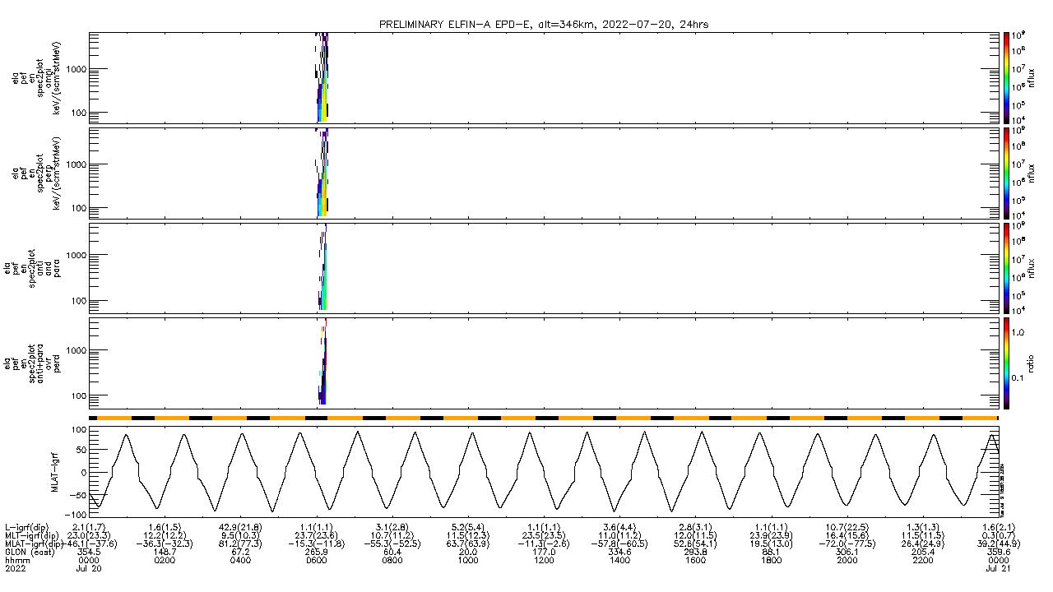
7/20/2022 (24hr)
Energetic Particle Detector for electrons
ELFIN-A, Electron-Flux, alt=346km
J_{OMNI}
keV/(cm²/sr/s/MeV)
e-flux
J_{ꓕ}
keV/(cm²/sr/s/MeV)
e-flux
J_{anti+para}
keV/(cm²/sr/s/MeV)
e-flux
J_{prec} / J_{ꓕ}
keV/(cm²/sr/s/MeV)
ratio
Sun / Shadow
MLAT

Slide 52
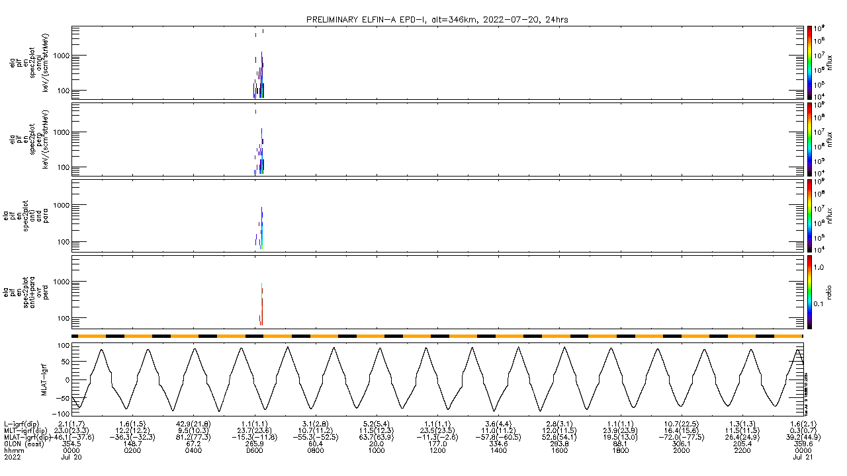
7/20/2022 (24hr)
Energetic Particle Detector for ions
ELFIN-A, Ion-Flux, alt=346km
J_{OMNI}
keV/(cm²/sr/s/MeV)
i-flux
J_{ꓕ}
keV/(cm²/sr/s/MeV)
i-flux
J_{anti+para}
keV/(cm²/sr/s/MeV)
i-flux
J_{prec} / J_{ꓕ}
keV/(cm²/sr/s/MeV)
ratio
Sun / Shadow
MLAT

Slide 53
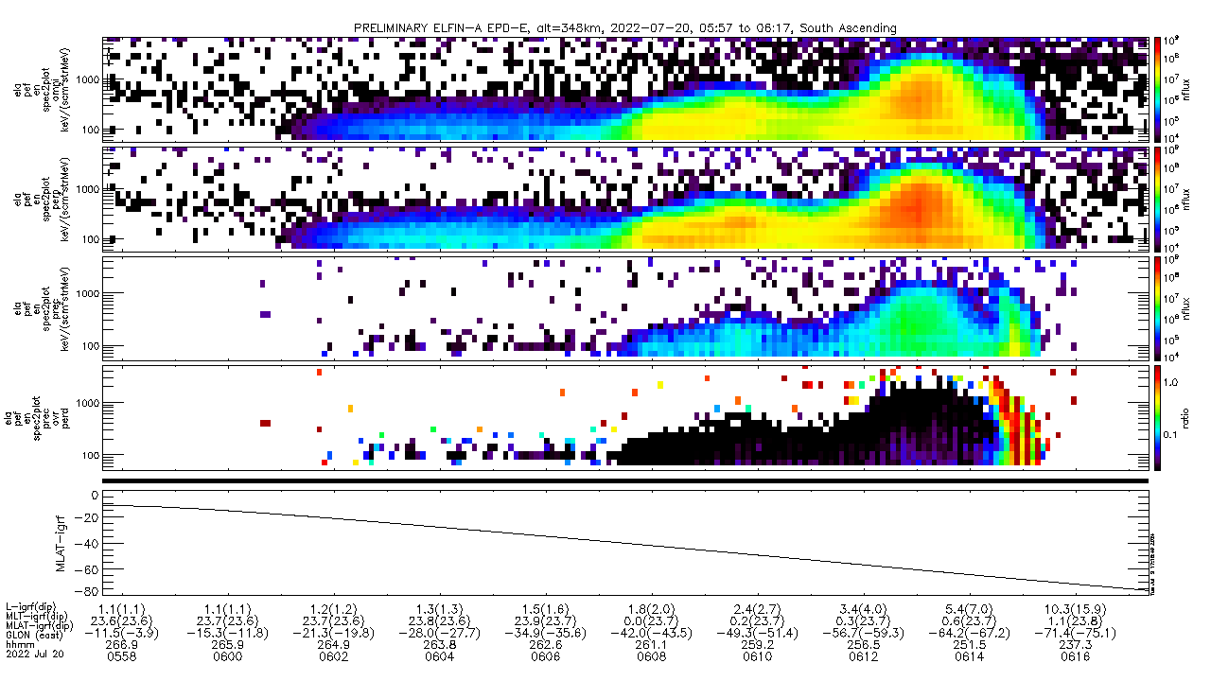
7/20/2022 (05:57:38 – 06:17:23 UTC)
Energetic Particle Detector for electrons
ELFIN-A, Electron-Flux, alt=348km, South Ascending
J_{OMNI}
keV/(cm²/sr/s/MeV)
e-flux
J_{ꓕ}
keV/(cm²/sr/s/MeV)
e-flux
J_{prec}
keV/(cm²/sr/s/MeV)
e-flux
J_{prec} / J_{ꓕ}
keV/(cm²/sr/s/MeV)
ratio
Sun / Shadow
MLAT

Slide 54
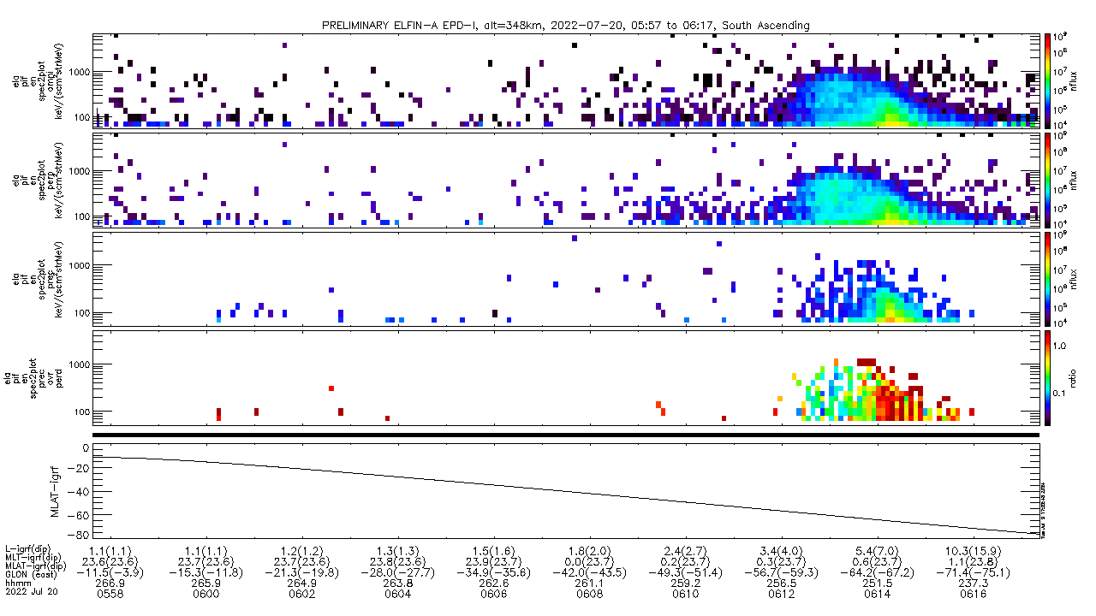
7/20/2022 (05:57:38 – 06:17:23 UTC)
Energetic Particle Detector for ions
ELFIN-A, Ion-Flux, alt=348km, South Ascending
J_{OMNI}
keV/(cm²/sr/s/MeV)
i-flux
J_{ꓕ}
keV/(cm²/sr/s/MeV)
i-flux
J_{prec}
keV/(cm²/sr/s/MeV)
i-flux
J_{prec} / J_{ꓕ}
keV/(cm²/sr/s/MeV)
ratio
Sun / Shadow
MLAT

Slide 55
ELFIN - B
B/STAR
**Note: I ordered ELFIN-B spectrograms showing electron-flux first then ion-flux because they both cover the exact same time period, so that way, you can make a quick glance of a comparison between the e-flux and ion-flux.

Slide 56
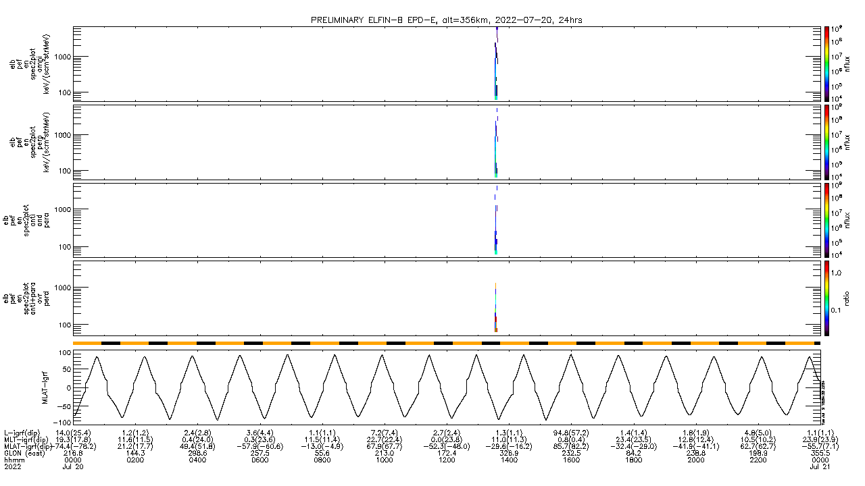
7/20/2022 (24hr)
Energetic Particle Detector for electrons
ELFIN-B, Electron-Flux, alt=356km
J_{OMNI}
keV/(cm²/sr/s/MeV)
e-flux
J_{ꓕ}
keV/(cm²/sr/s/MeV)
e-flux
J_{prec}
keV/(cm²/sr/s/MeV)
e-flux
J_{prec} / J_{ꓕ}
keV/(cm²/sr/s/MeV)
ratio
Sun / Shadow
MLAT

Slide 57
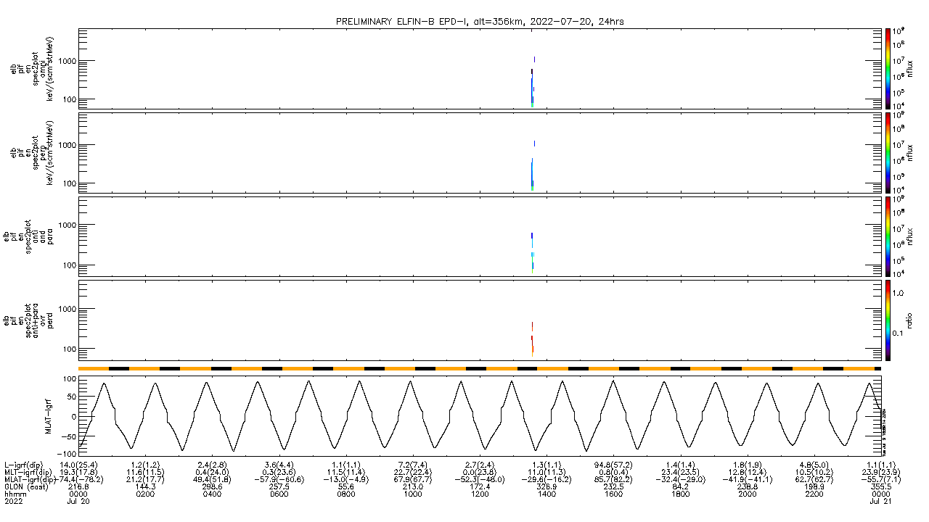
7/20/2022 (24hr)
Energetic Particle Detector for ions
ELFIN-B, Ion-Flux, alt=356km
J_{OMNI}
keV/(cm²/sr/s/MeV)
i-flux
J_{ꓕ}
keV/(cm²/sr/s/MeV)
i-flux
J_{prec}
keV/(cm²/sr/s/MeV)
i-flux
J_{prec} / J_{ꓕ}
keV/(cm²/sr/s/MeV)
ratio
Sun / Shadow
MLAT

Slide 58
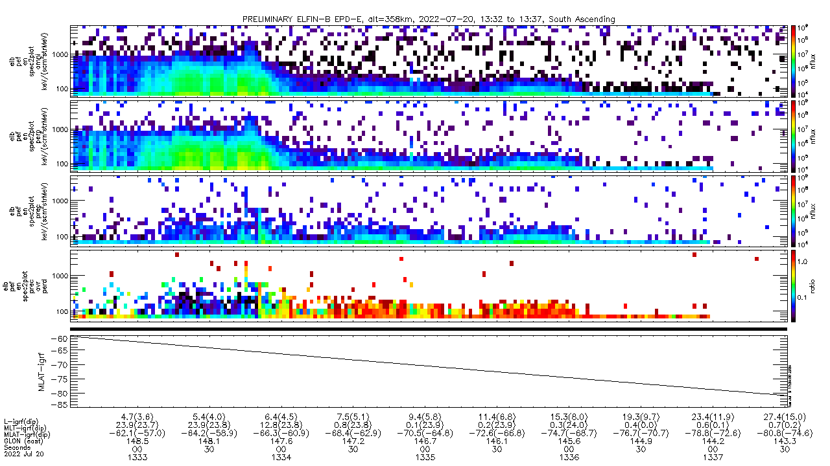
7/20/2022 (13:32:32 – 13:37:31 UTC)
Energetic Particle Detector for electrons
ELFIN-B, Electron-Flux, alt=358km, South Ascending
J_{OMNI}
keV/(cm²/sr/s/MeV)
e-flux
J_{ꓕ}
keV/(cm²/sr/s/MeV)
e-flux
J_{prec}
keV/(cm²/sr/s/MeV)
e-flux
J_{prec} / J_{ꓕ}
keV/(cm²/sr/s/MeV)
ratio
Sun / Shadow
MLAT

Slide 59
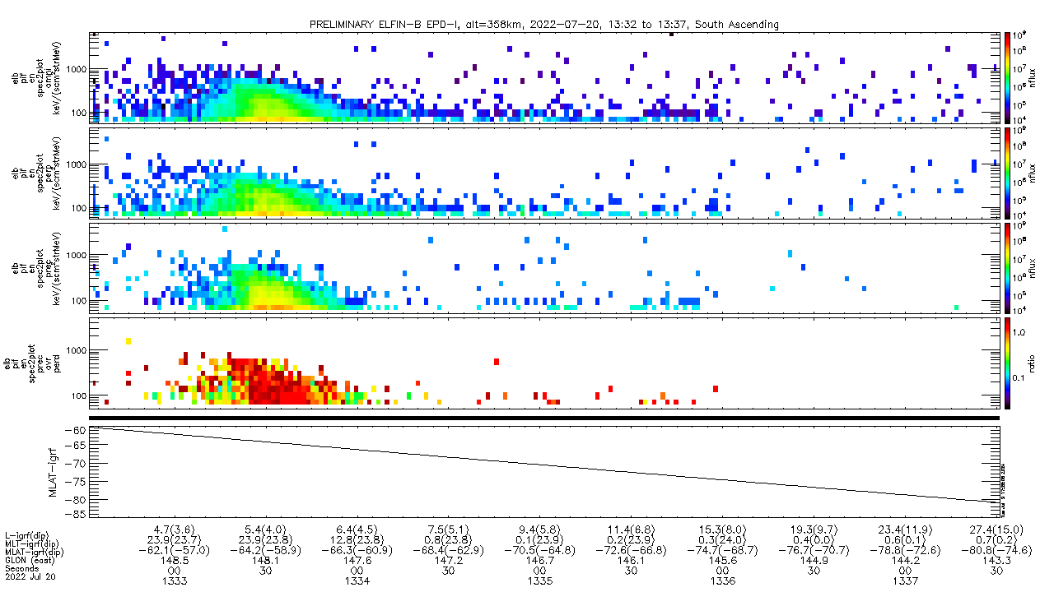
7/20/2022 (13:32:32 – 13:37:31 UTC)
Energetic Particle Detector for electrons
ELFIN-B, Ion-Flux, alt=358km, South Ascending
J_{OMNI}
keV/(cm²/sr/s/MeV)
i-flux
J_{ꓕ}
keV/(cm²/sr/s/MeV)
i-flux
J_{prec}
keV/(cm²/sr/s/MeV)
i-flux
J_{prec} / J_{ꓕ}
keV/(cm²/sr/s/MeV)
ratio
Sun / Shadow
MLAT

